Slide 1




What metrics matter in Soccer?
4/10/2020
Takeshi Sugiyama

Slide 2
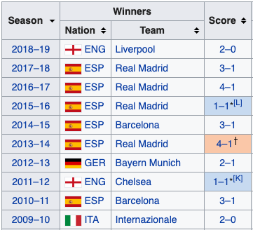
Dataset
Stats of 10 years from England, Spain, Germany, and Italy.
40 CSV files from a soccer betting website.
14466 rows and 80 columns of preprocessed data. Filtered out;
columns that had > 1% null values
betting odds column
3 Italian games that had null values
Ended up with 14457 rows and 26 columns after cleaning.
German league had 34 games per season compared to 38 games for all other leagues so worked with averages.
UEFA Champions League Winners
Photo from Wikipedia

Slide 3
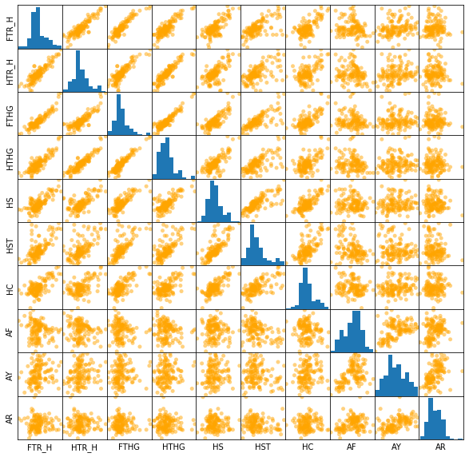
Which metrics contribute to wins?
Compared 9 metrics that seemed to have a correlation with wins in a scatter matrix.
Goals
Half Time Lead
Half Time Goals
Shots
Shots on Target
Corner Kicks
Fouls
Yellow Cards
Red Card

Slide 4
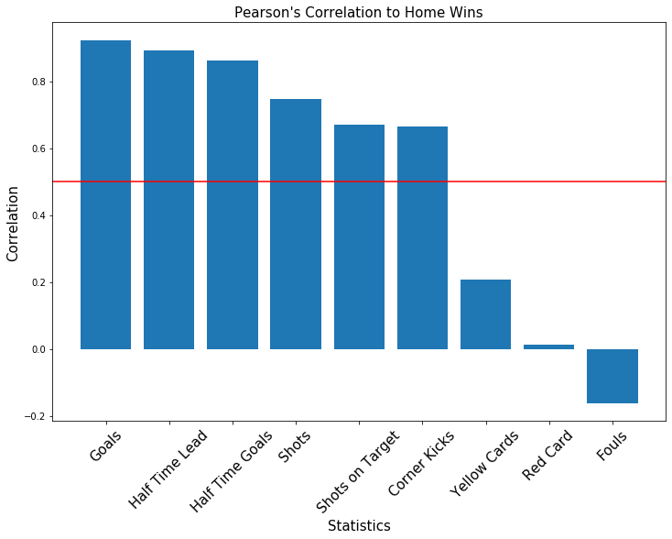
Quantified correlation of wins using Pearson's method
Positive correlation with >= 0.5
Goals: 0.92
Half time lead: 0.89
Half time goals: 0.86
Shots: 0.75
Shots on Target: 0.67
Corner Kicks: 0.66
No correlation with < 0.5 & > -0.5
Yellow Cards: 0.21
Red Cards: 0.01
Fouls: -0.16

Slide 5
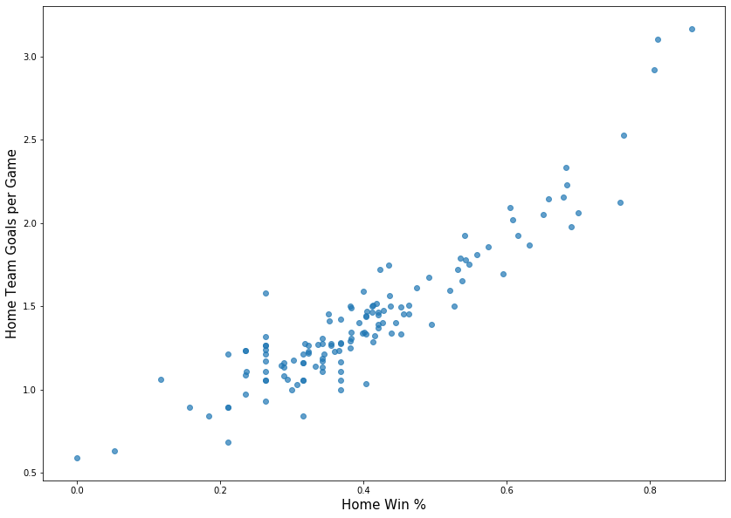
Scatter Plot of Wins vs Goals Per Game

Slide 6
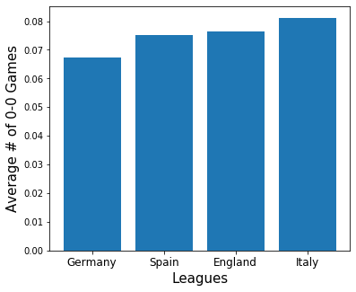
Goals matter. The average number of games resulting in a (boring) 0-0 result is 7.5%.
1,090 games ended in a 0-0 result out of 14,457 games in the last 10 years.
Averages among leagues;
Germany: 6.7%
Spain: 7.5%
England: 7.6%
Italy: 8.1%

Slide 7
Hypothesis Test 1: Is the average number of games with 0-0 score lower than 8% (approx 1/12)?
Null hypothesis: The average number of games with 0 goal = 8%.
Alternative hypothesis: The average number of games with 0 goal < 8%.
P-Value = 0.05

Slide 8
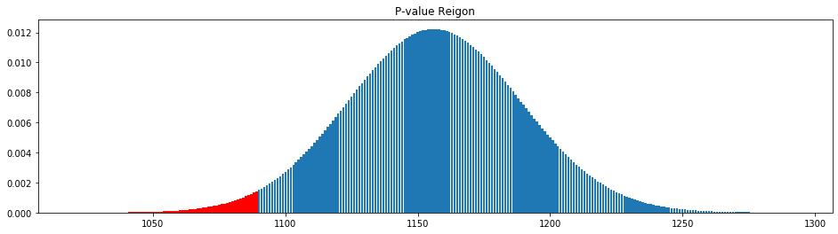
Hypothesis Test 1 Result:
Probability of Observing Data Equal or More Extreme than Actual (P-Value): 0.021
Since this is below the 0.05 threshold, we can reject the null hypothesis. The alternative hypothesis of the average number of games with 0 goals < 8%.

Slide 9
Hypothesis Test 2: Does the German league, on average have a lower 0-0 resulting games compared to the Italian league?
Null hypothesis: The average number of games with 0 goals in Germany = Italy.
Alternative hypothesis: The average number of games with 0 goals in Germany < Italy
P-Value = 0.05

Slide 10
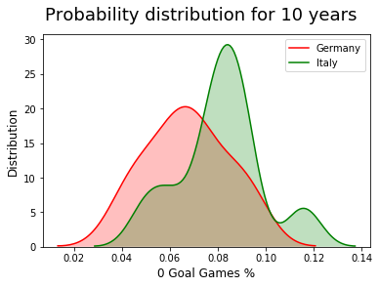
Hypothesis Test 2 Result:
Welch’s T-Test P-Value: 0.092 Mann-Whitney U-Test P-Value: 0.14
Since both results are above the 0.05 threshold, we cannot reject the null hypothesis that the average number of games with 0 goals in Germany = Italy.

